Slide 1
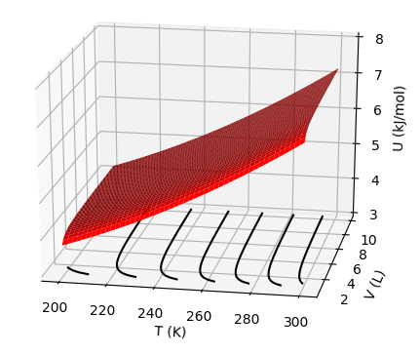



Recap: Identifying slopes of U(T,V)
$${\left(\frac{∂U}{∂T}\right)}_{V}$$
$${\left(\frac{∂U}{∂V}\right)}_{T}$$
$$dU={{\left(\frac{∂U}{∂T}\right)}_{V}dT+ \left(\frac{∂U}{∂V}\right)}_{T}dV=C_{V}dT+π_{T}dV$$

Slide 2
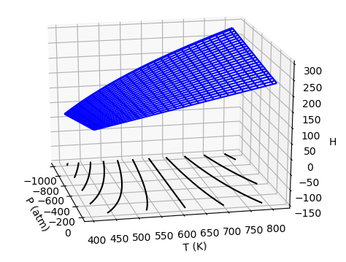



Recap: Identifying slopes of H(T,P)
$${\left(\frac{∂H}{∂T}\right)}_{P}$$
$${\left(\frac{∂H}{∂P}\right)}_{T}$$
$$dH={{\left(\frac{∂H}{∂T}\right)}_{P}dT+ \left(\frac{∂H}{∂P}\right)}_{T}dP=C_{P}dT+μ_{T}dP$$

Slide 3
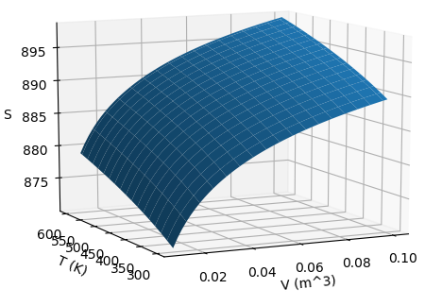
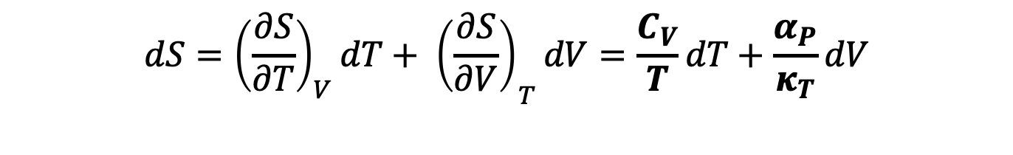


Recap: Identifying slopes of S(T,V)
$${\left(\frac{∂S}{∂T}\right)}_{V}$$
$${\left(\frac{∂S}{∂V}\right)}_{T}$$
$$dS={{\left(\frac{∂S}{∂T}\right)}_{V}dT+ \left(\frac{∂S}{∂V}\right)}_{T}dV=\frac{C_{V}}{T}dT+\frac{α_{P}}{κ_{T}}dV$$

Slide 4
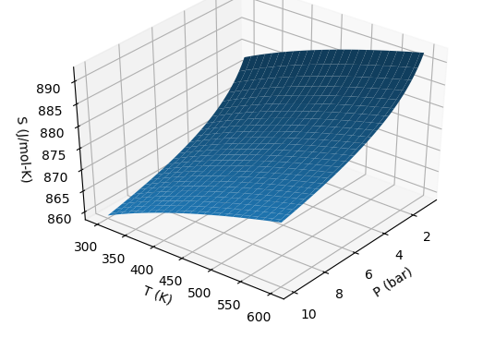
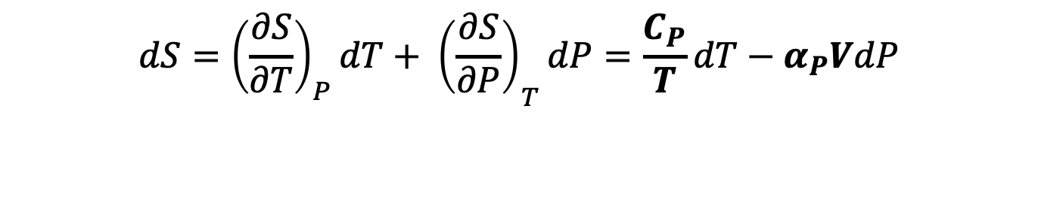


Recap: Identifying slopes of S(T,P)
$${\left(\frac{∂S}{∂P}\right)}_{T}$$
$${\left(\frac{∂S}{∂T}\right)}_{P}$$
$$dS={{\left(\frac{∂S}{∂T}\right)}_{P}dT+ \left(\frac{∂S}{∂P}\right)}_{T}dP=\frac{C_{P}}{T}dT−α_{P}VdP$$

Slide 5
Recap: Summary of measurable quantities

Slide 6
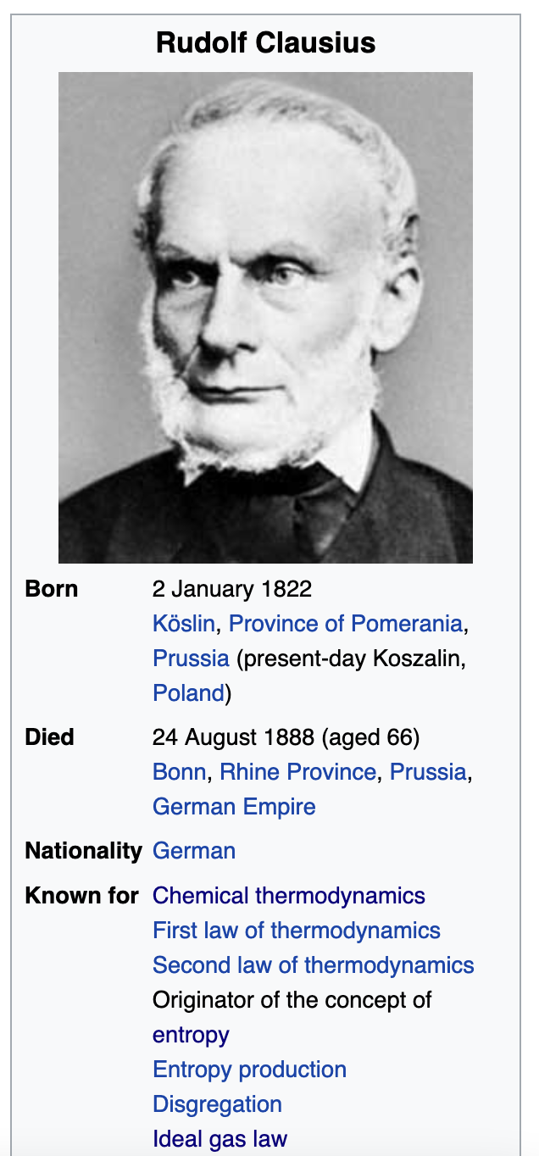
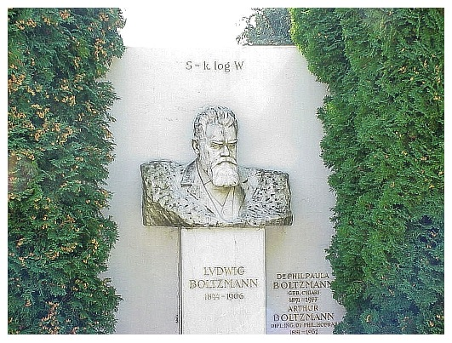
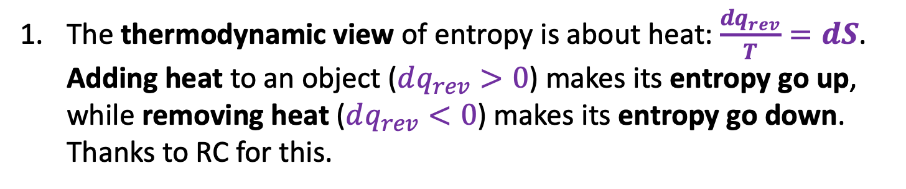
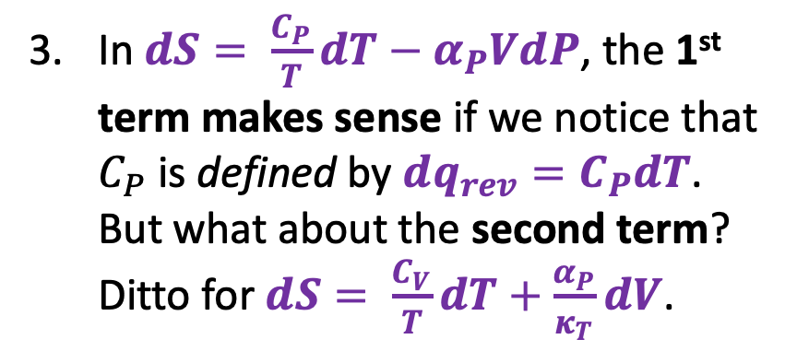
Recap: Thermodynamic and statistical visions of entropy
The thermodynamic view of entropy is about heat: $\frac{dq_{rev}}{T}=dS$. Adding heat to an object ($dq_{rev}>0$) makes its entropy go up, while removing heat ($dq_{rev}<0$) makes its entropy go down. Thanks to RC for this.
The statistical view is all about choice – more choice (in energy or position) means more entropy. Choice is quantified by Wahrscheinlichkeit (the German word for probability), and is the “W” on LB’s gravestone. (We’ll get to this later if we can.)
In $dS= \frac{C_{P}}{T}dT−α_{P}VdP$, the 1st term makes sense if we notice that $C_{P}$ is defined by $dq_{rev}=C_{P}dT$. But what about the second term? Ditto for $dS= \frac{C_{V}}{T}dT+\frac{α_{P}}{κ_{T}}dV$.

Slide 7
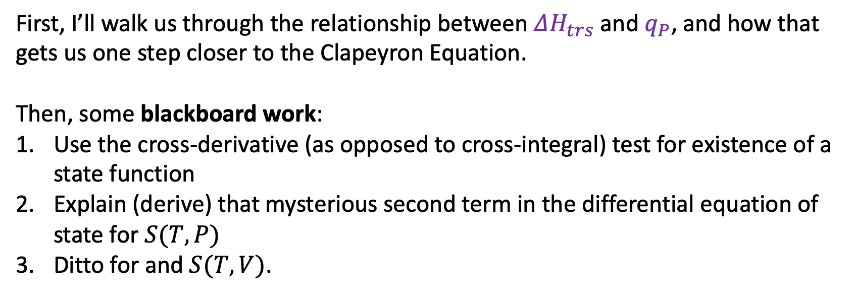
Roadmap for today
First, I’ll walk us through the relationship between $ΔH_{trs}$ and $q_{P}$, and how that gets us one step closer to the Clapeyron Equation.
Then, some blackboard work:
Use the cross-derivative (as opposed to cross-integral) test for existence of a state function
Explain (derive) that mysterious second term in the differential equation of state for $S(T,P)$
Ditto for and $S(T,V)$.

Slide 8
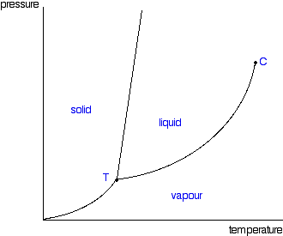

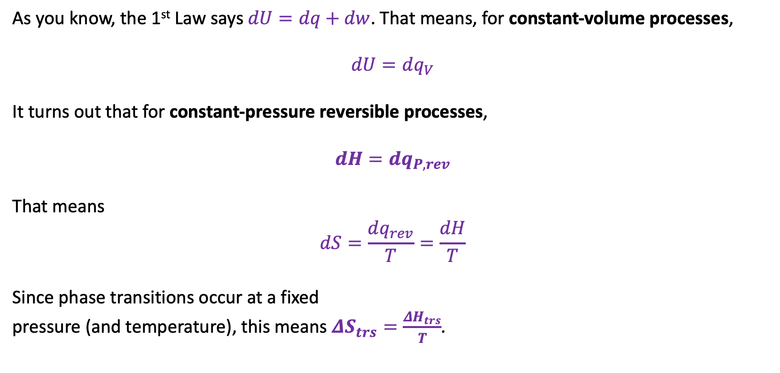
$ΔH_{trs}$ , $q_{P}$, and getting one step closer to the Clapeyron Equation
As you know, the 1st Law says $dU=dq+dw$. That means, for constant-volume processes,
$$dU=dq_{V}$$
It turns out that for constant-pressure reversible processes,
$$dH=dq_{P,rev}$$
That means
$$dS=\frac{dq_{rev}}{T}=\frac{dH}{T}$$
Since phase transitions occur at a fixed
pressure (and temperature), this means $ΔS_{trs}=\frac{ΔH_{trs}}{T}$.
$$∆S_{vap}$$
$$∆H_{vap}$$
$$∆V_{vap}$$

Slide 9
$ΔH_{trs}$ , $q_{P}$, and getting one step closer to the Clapeyron Equation
As you know, the 1st Law says $dU=dq+dw$. That means, for constant-volume processes,
$$dU=dq_{V}$$
It turns out that for constant-pressure reversible processes,
$$dH=dq_{P,rev}$$
That means
$$dS=\frac{dq_{rev}}{T}=\frac{dH}{T}$$
Since phase transitions occur at a fixed
pressure (and temperature), this means $ΔS_{trs}=\frac{ΔH_{trs}}{T}$.
You should probably commit this to memory too
$$∆S_{vap}$$
$$∆H_{vap}$$
$$∆V_{vap}$$

Slide 10
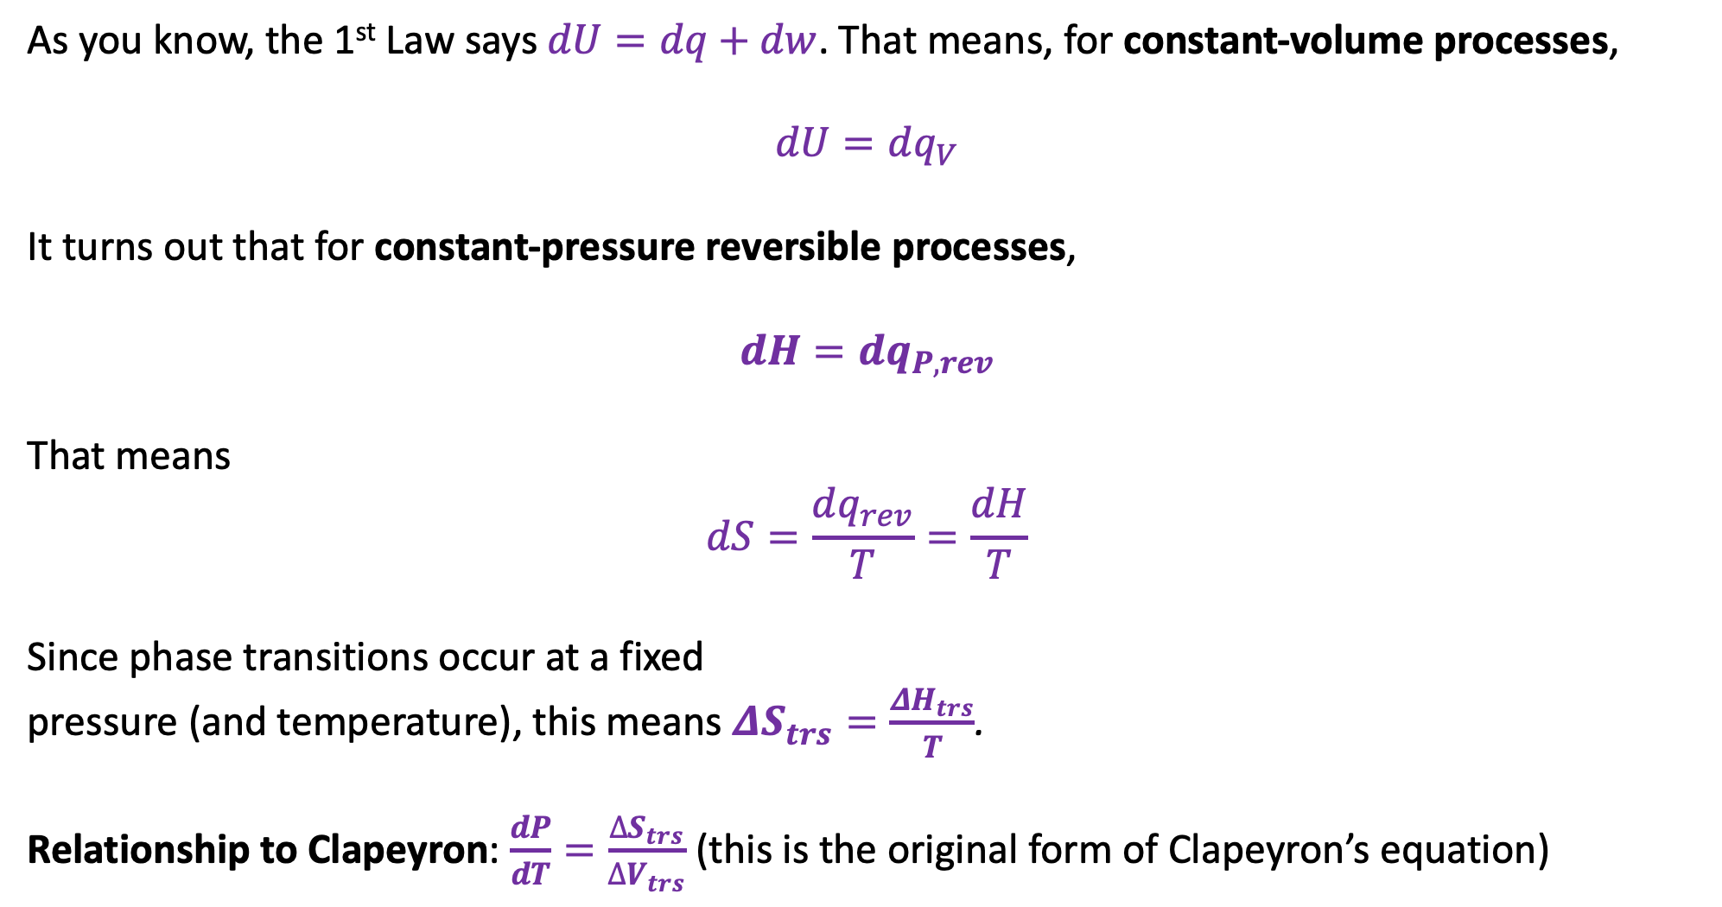
Getting one step closer to the Clapeyron Equation
As you know, the 1st Law says $dU=dq+dw$. That means, for constant-volume processes,
$$dU=dq_{V}$$
It turns out that for constant-pressure reversible processes,
$$dH=dq_{P,rev}$$
That means
$$dS=\frac{dq_{rev}}{T}=\frac{dH}{T}$$
Since phase transitions occur at a fixed
pressure (and temperature), this means $ΔS_{trs}=\frac{ΔH_{trs}}{T}$.
Relationship to Clapeyron: $\frac{dP}{dT}=\frac{∆S_{trs}}{∆V_{trs}}$ (this is the original form of Clapeyron’s equation)
You should probably commit this to memory too
$$∆S_{vap}$$
$$∆H_{vap}$$
$$∆V_{vap}$$

Slide 11
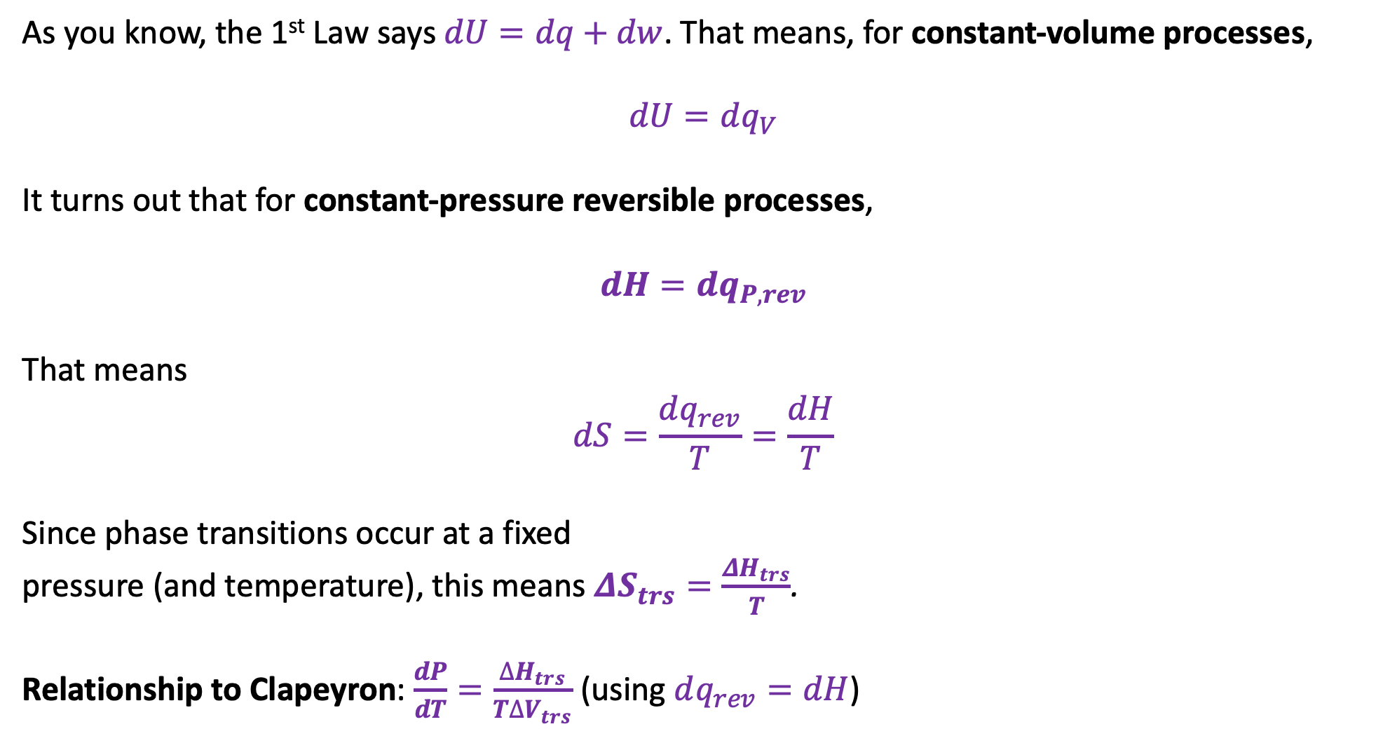
Getting one step closer to the Clapeyron Equation
As you know, the 1st Law says $dU=dq+dw$. That means, for constant-volume processes,
$$dU=dq_{V}$$
It turns out that for constant-pressure reversible processes,
$$dH=dq_{P,rev}$$
That means
$$dS=\frac{dq_{rev}}{T}=\frac{dH}{T}$$
Since phase transitions occur at a fixed
pressure (and temperature), this means $ΔS_{trs}=\frac{ΔH_{trs}}{T}$.
Relationship to Clapeyron: $\frac{dP}{dT}=\frac{∆H_{trs}}{T∆V_{trs}}$ (using $dq_{rev}=dH$)
You should probably commit this to memory too
$$∆S_{vap}$$
$$∆H_{vap}$$
$$∆V_{vap}$$

Slide 12
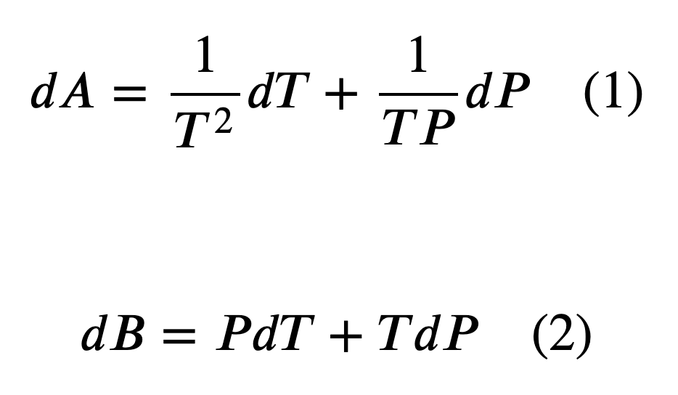
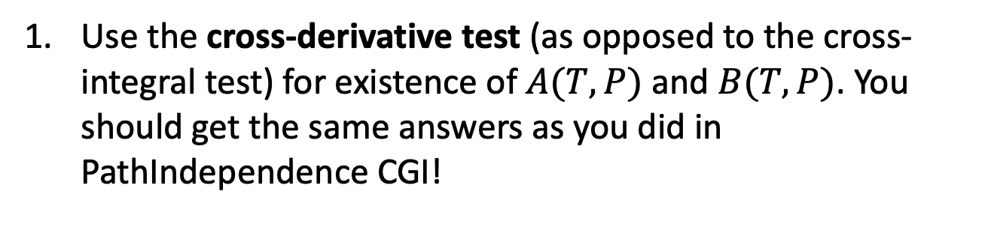
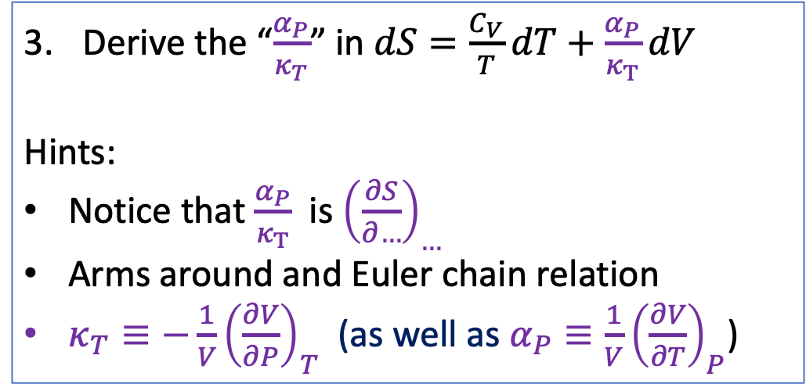
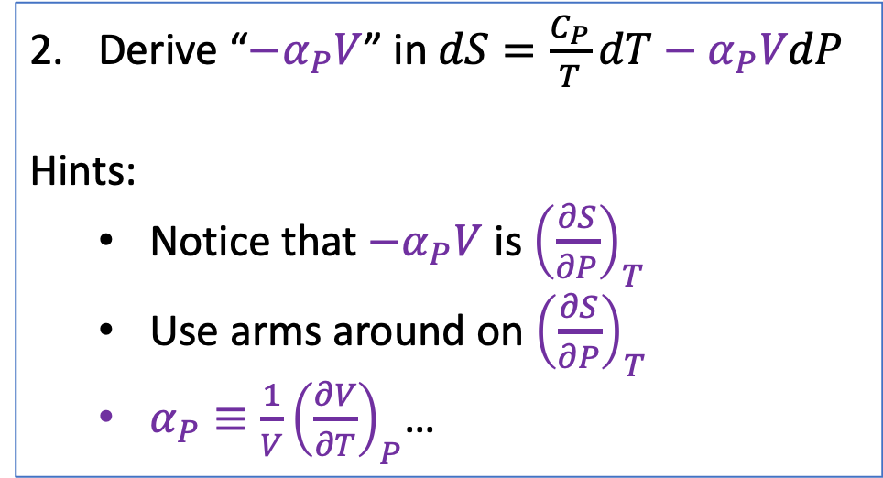
Blackboard tasks
Use the cross-derivative test (as opposed to the cross-integral test) for existence of $A(T,P)$ and $B(T,P)$. You should get the same answers as you did in PathIndependence CGI!
Derive “${−α}_{P}V$” in $dS=\frac{C_{P}}{T}dT−α_{P}VdP$
Hints:
Notice that $−α_{P}V$ is ${\left(\frac{∂S}{∂P}\right)}_{T}$
Use arms around on ${\left(\frac{∂S}{∂P}\right)}_{T}$
$α_{P}≡\frac{1}{V}{\left(\frac{∂V}{∂T}\right)}_{P}$…
Derive the “$\frac{α_{P}}{κ_{T}}$” in $dS=\frac{C_{V}}{T}dT+\frac{α_{P}}{κ_{T}}dV$
Hints:
Notice that $\frac{α_{P}}{κ_{T}}$ is ${\left(\frac{∂S}{∂…}\right)}_{…}$
Arms around and Euler chain relation
$κ_{T}≡−\frac{1}{V}{\left(\frac{∂V}{∂P}\right)}_{T}$ (as well as $α_{P}≡\frac{1}{V}{\left(\frac{∂V}{∂T}\right)}_{P}$)

